Slide 1
Review
1.Structure of the course
Lexical Analysis
RG & DFA
Grammar & Language
Top-down LL(1) Parsing
Bottom-Up Precedence and LR
Layered Automation
Syntax Analysis
Semantic Analysis
Attribute Grammar
Type Checking
Run-time Environment
Intermediate Code generation
TAC
Quadruple(Backpatching)
Stack Allocations
Control-flow Analysis
Data-flow Analysis
Code Optimization

Slide 2
Review
2.Scope of reviewing
From Chapter 2-Chapter 9

Slide 3
Review
3.Methods of reviewing
Understanding basic concept, principles deeply
Being able to do exercises
Understanding the process by drawing the graph or the flow
Remembering after understanding

Slide 4
Review
4.Forms of problems in the examination paper
Similar to the exercises finished by you
Without any the form of choosing answers or judgment

Slide 5
Review
5.Form of examination
Closed (Cannot refer to any other materials)

Slide 6
Review
6.Important knowledge points
Chapter 2
Chomsky Grammar and related Automation
Construct a context-free grammar without ε-production from a language
All strings of a’s and b’s with an even number of a’s and an odd number of b’s
Strings of a’s and b’s w9ith an equal number of a’s and b’s
Embedded grammar
Combination of regular grammar and embedded grammar

Slide 7
Please construct context-free grammars with ε-free production for the following language.
L={ω| ω∈(a,b,c,d)* and the numbers of a’s and b’s and d’s occurred in ω are odd, and ω starts with a , ends with b}

Slide 8
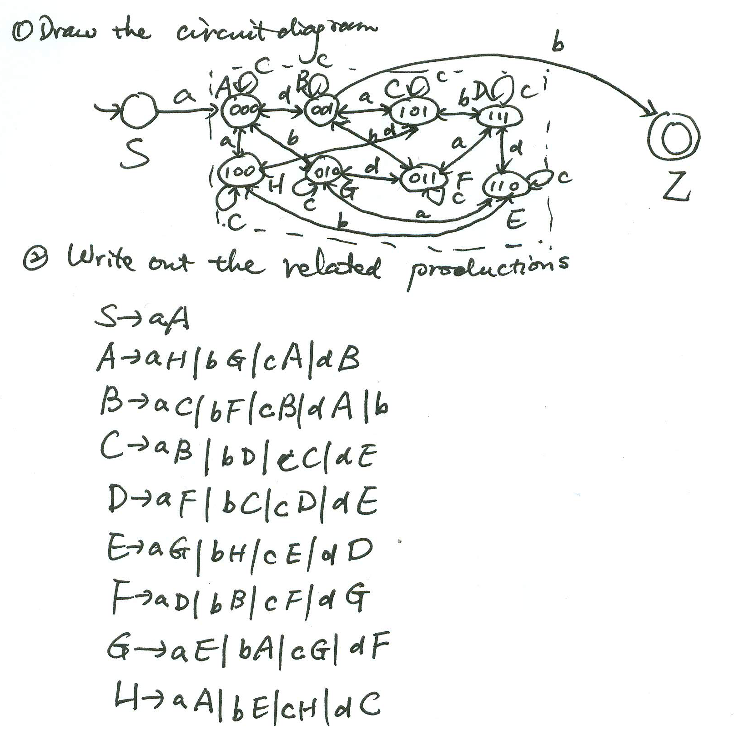

Slide 9
Review
6.Important knowledge points
Chapter 3
Conversion from NFA to DFA
Subset Method
Minimizing of DFA
Top-down partition of equivalent class
Conversion from Regular expression to NFA and inverse conversion
Conversion from Regular Grammar to NFA and inverse conversion
Construct a minimum-state DFA for a regular expression

Slide 10
Please construct a DFA with minimum states for the following regular expression.
((ab*)(a|b)*)*(a|b)(a|b)*

Slide 11
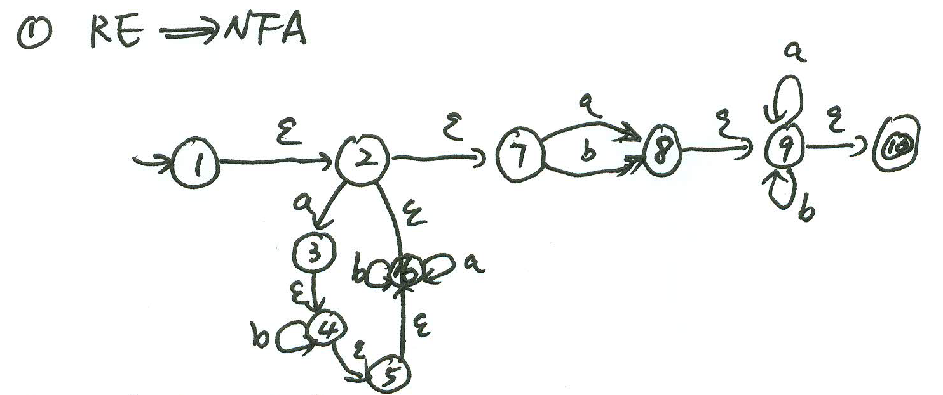

Slide 12
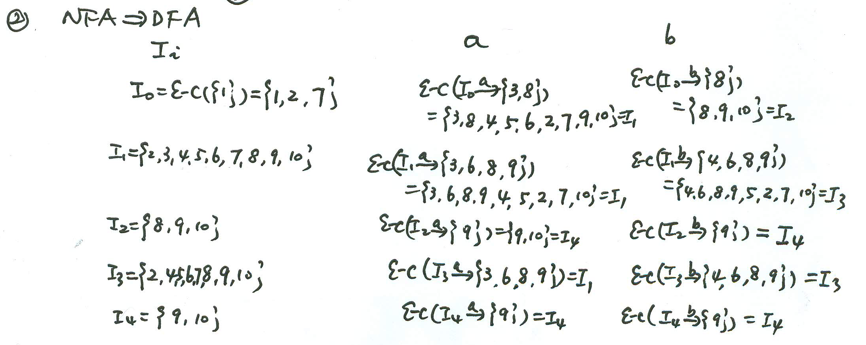
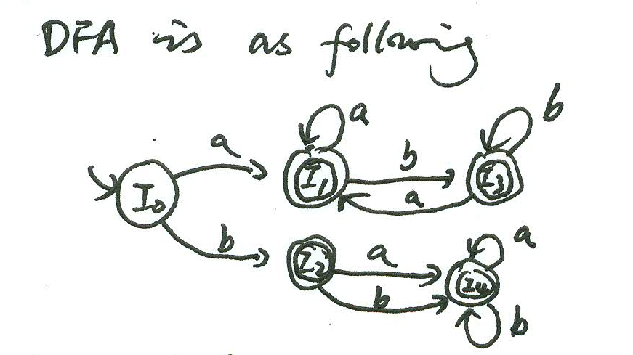

Slide 13
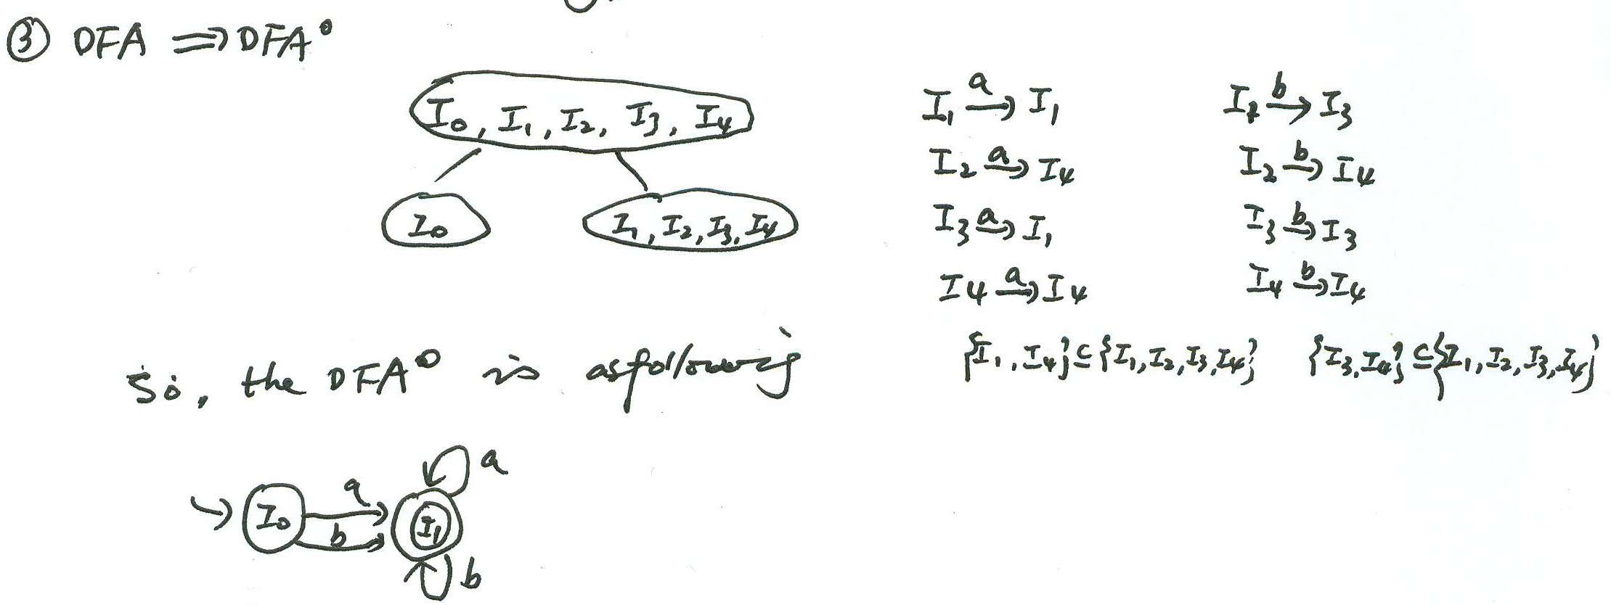

Slide 14
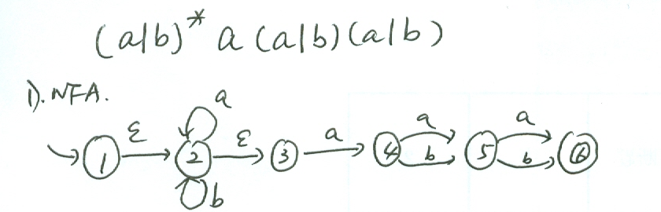

Slide 15
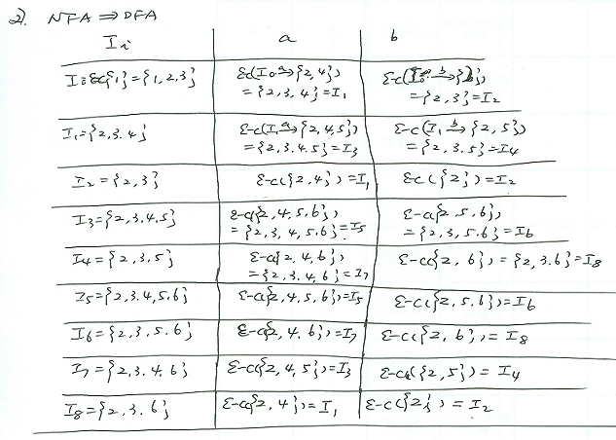

Slide 16
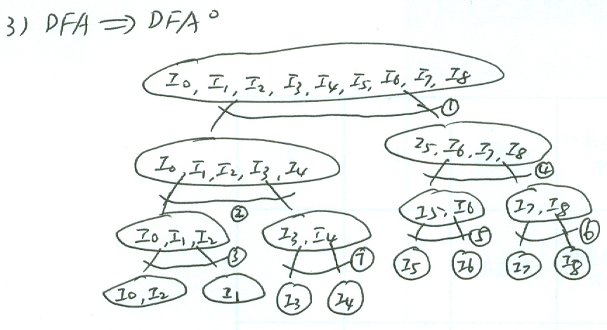

Slide 17
Review
6.Important knowledge points
Chapter 4
Top-down Parsing
Recursive descent parsing
Predictive parsing
LL(1)
LL(1) Parsing table construction
Elimination of left recursion
First direct, Next indirect recursion
Factoring
First &Follow
Show a CFG grammar is whether a LL(1) grammar by constructing the related parsing table

Slide 18
Please eliminate the left recursions (if there are) and extract maximum common left factors (if there are) from the following context free grammar, and then decide the resulted grammar is whether a LL(1) grammar by constructing the related LL(1) parsing table.
S→if E then S|if E then S else S|while E do S|a
E→E and F|F
F→F or G|G
G→(E)|b

Slide 19
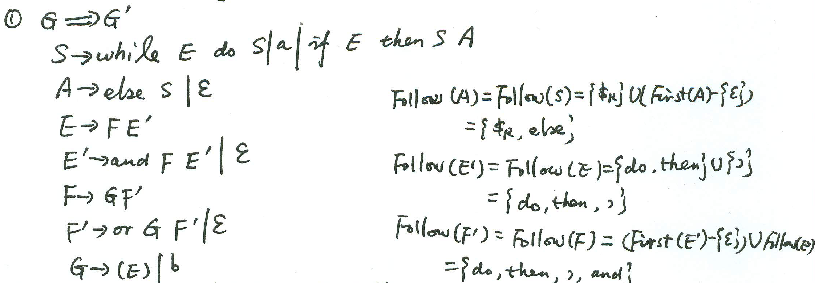

Slide 20
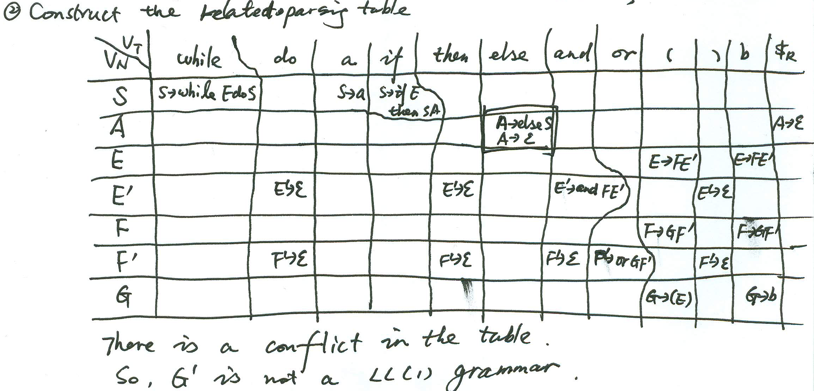

Slide 21
Review
6.Important knowledge points
Chapter 4
Bottom-up Parsing
LR parsing
SLR(1) -- Follow
LR(1) – Predictive symbol
LALR –Merging states with the same core
Show a CFG grammar is whether a LR grammar by constructing the related parsing table

Slide 22
Review
6.Important knowledge points
Chapter 4
Ambiguous Grammar parsing
Additional conditions
Associated law and precedence
Dangle rules
Parsing an ambiguous grammar in LR parsing method with additional conditions

Slide 23
Please construct a LR(1) parsing table for the following ambiguous grammar with your own defined additional conditions (You determine the required additional conditions by yourself).
E→E and E|E or E|not E|(E)|b

Slide 24
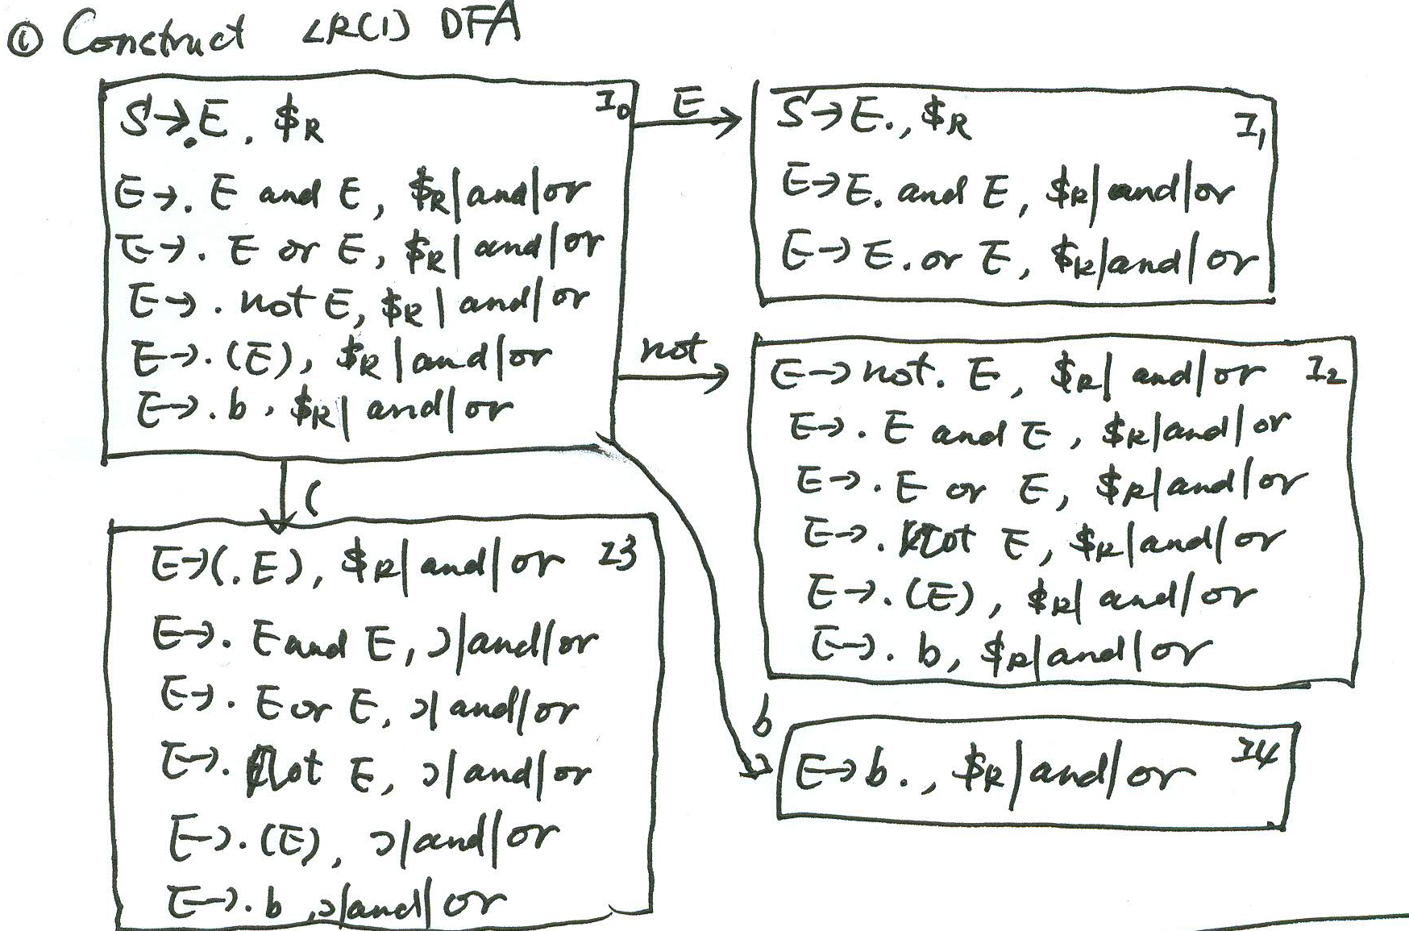

Slide 25
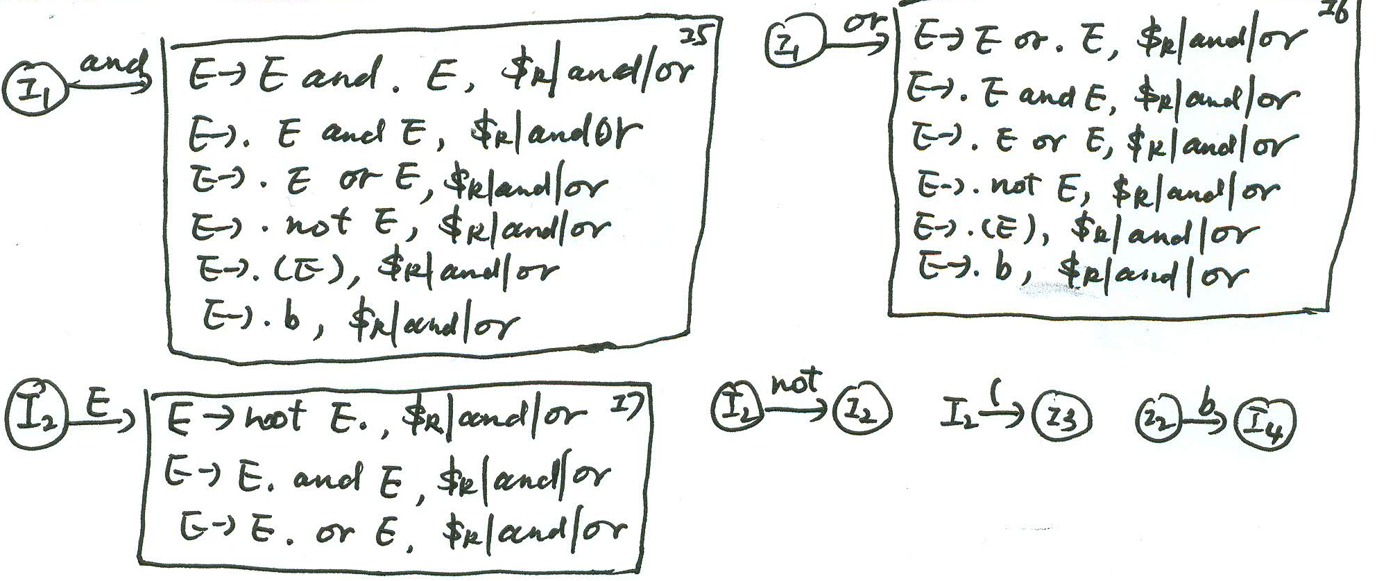

Slide 26
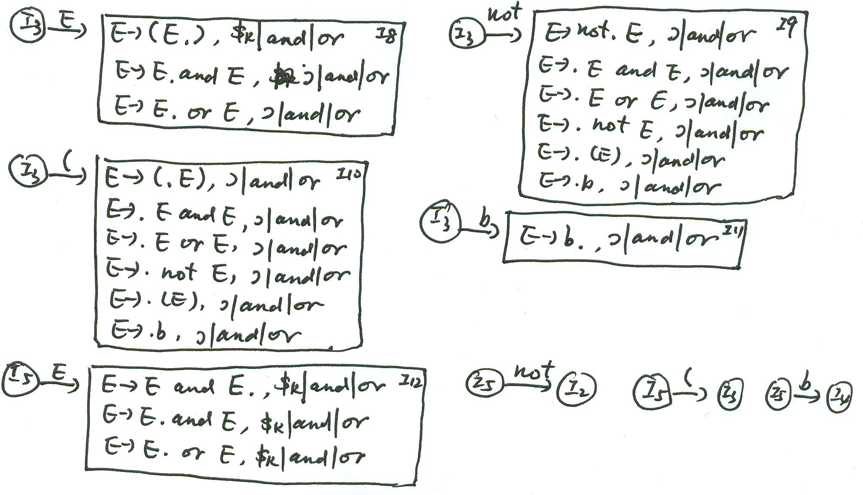

Slide 27
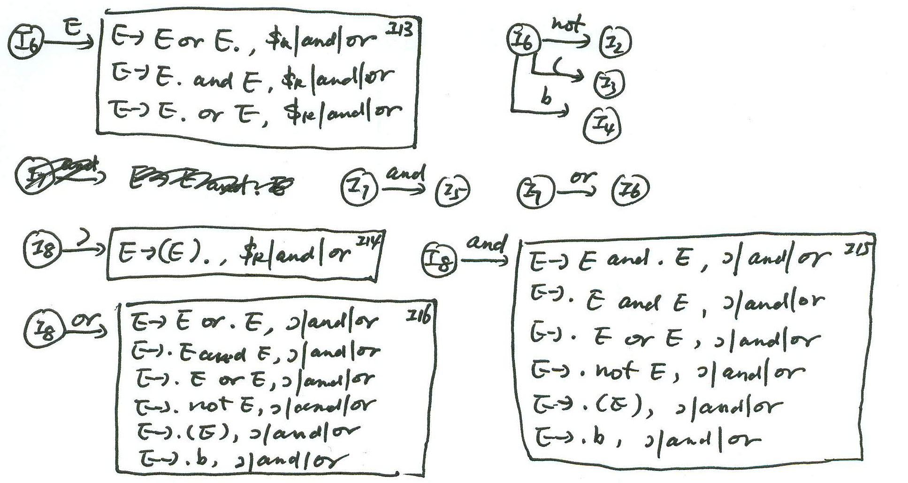

Slide 28
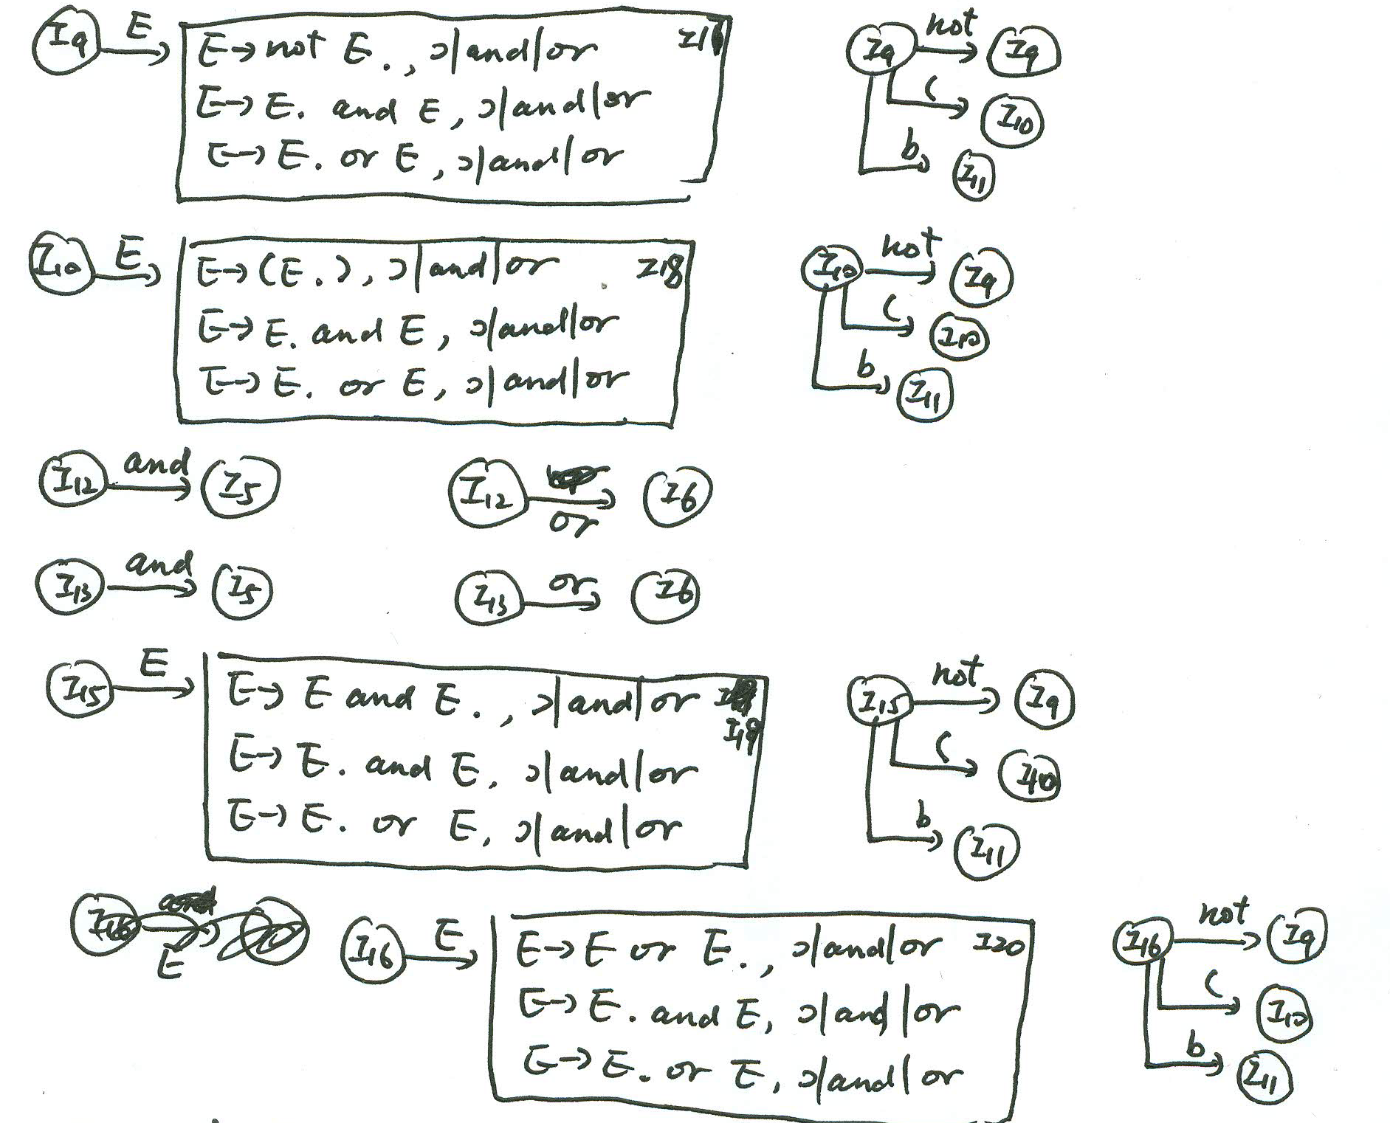

Slide 29
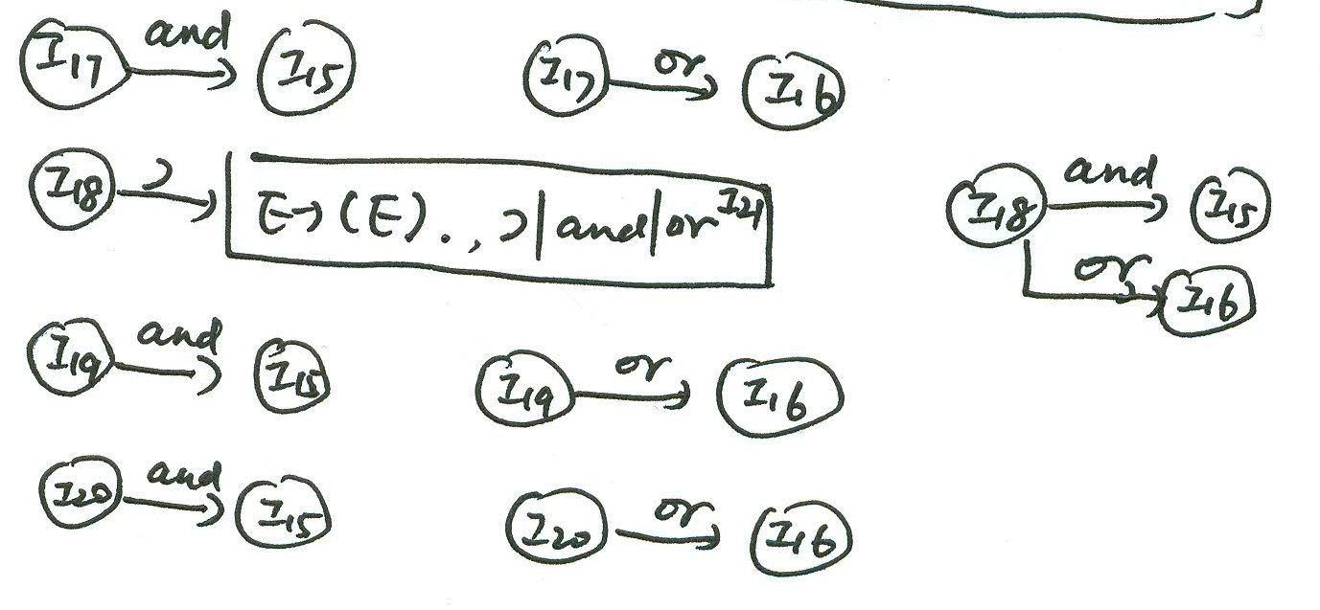

Slide 30
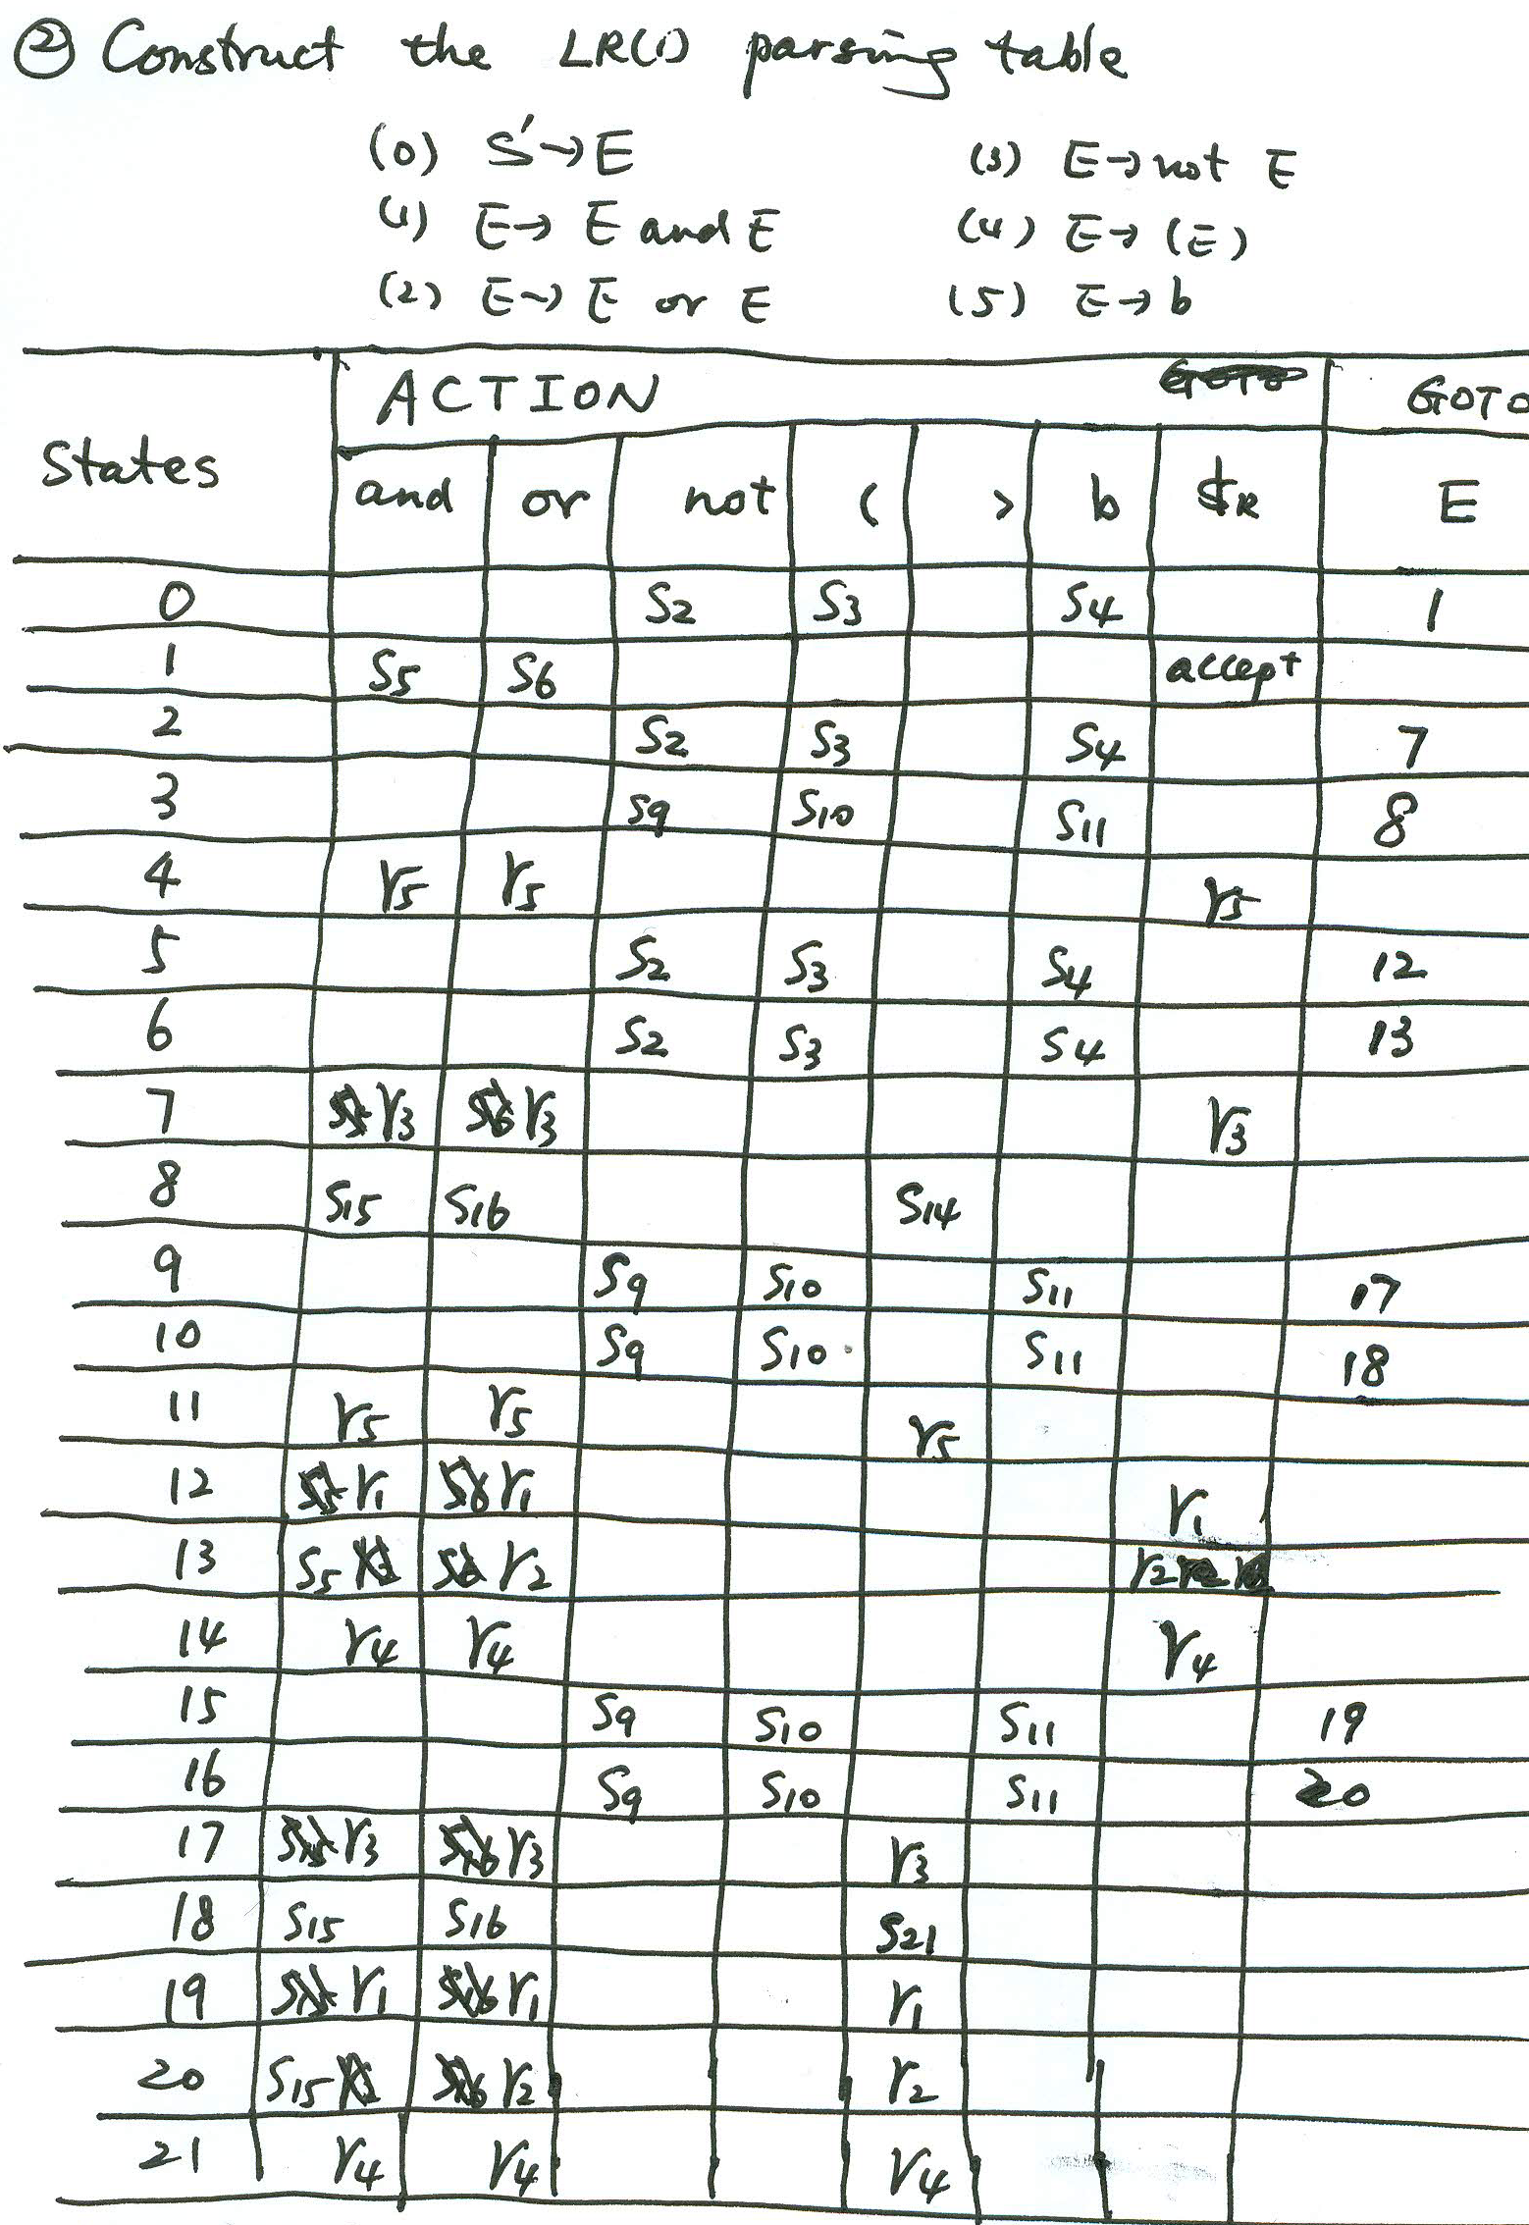

Slide 31
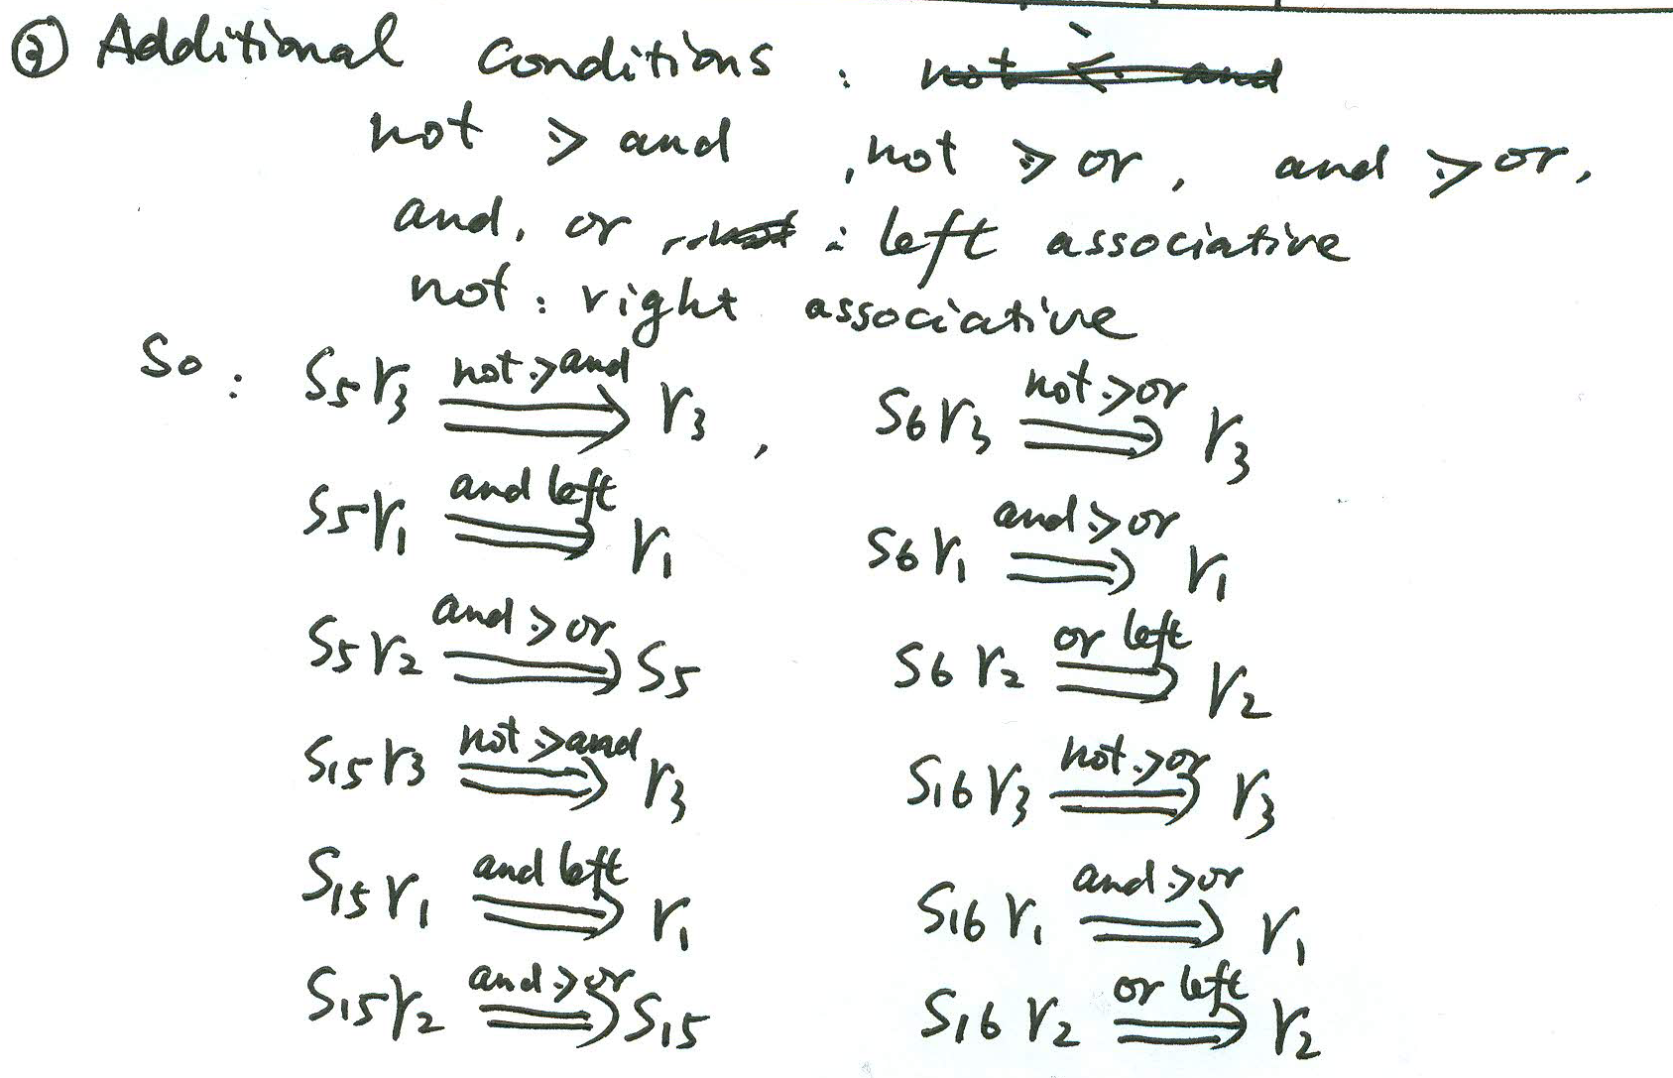

Slide 32
Review
6.Important knowledge points
Chapter 5
Attribute
Annotated parsing tree
Construct an annotated parsing tree for an expression (S-attribute)
Syntax-directed definition
S-attribute Grammar and evaluation of S-attribute
Construct semantic rules for a S-attribute grammar

Slide 33
Please construct an annotated parse tree for the input string 111.0111 where the syntax-directed definition is as following:
Productions Semantic Rules
S→L₁.L₂ {S.val=L₁.val+L₂.val/2^{L}2^{.len}}
S→L {S.val=L.val}
L→L₁B {L.val=L₁.val*2+B.val, L.len=L₁.len+1}
L→B {L.val=B.val,L.len=1}
B→0 {B.val=0}
B→1 {B.val=1}

Slide 34
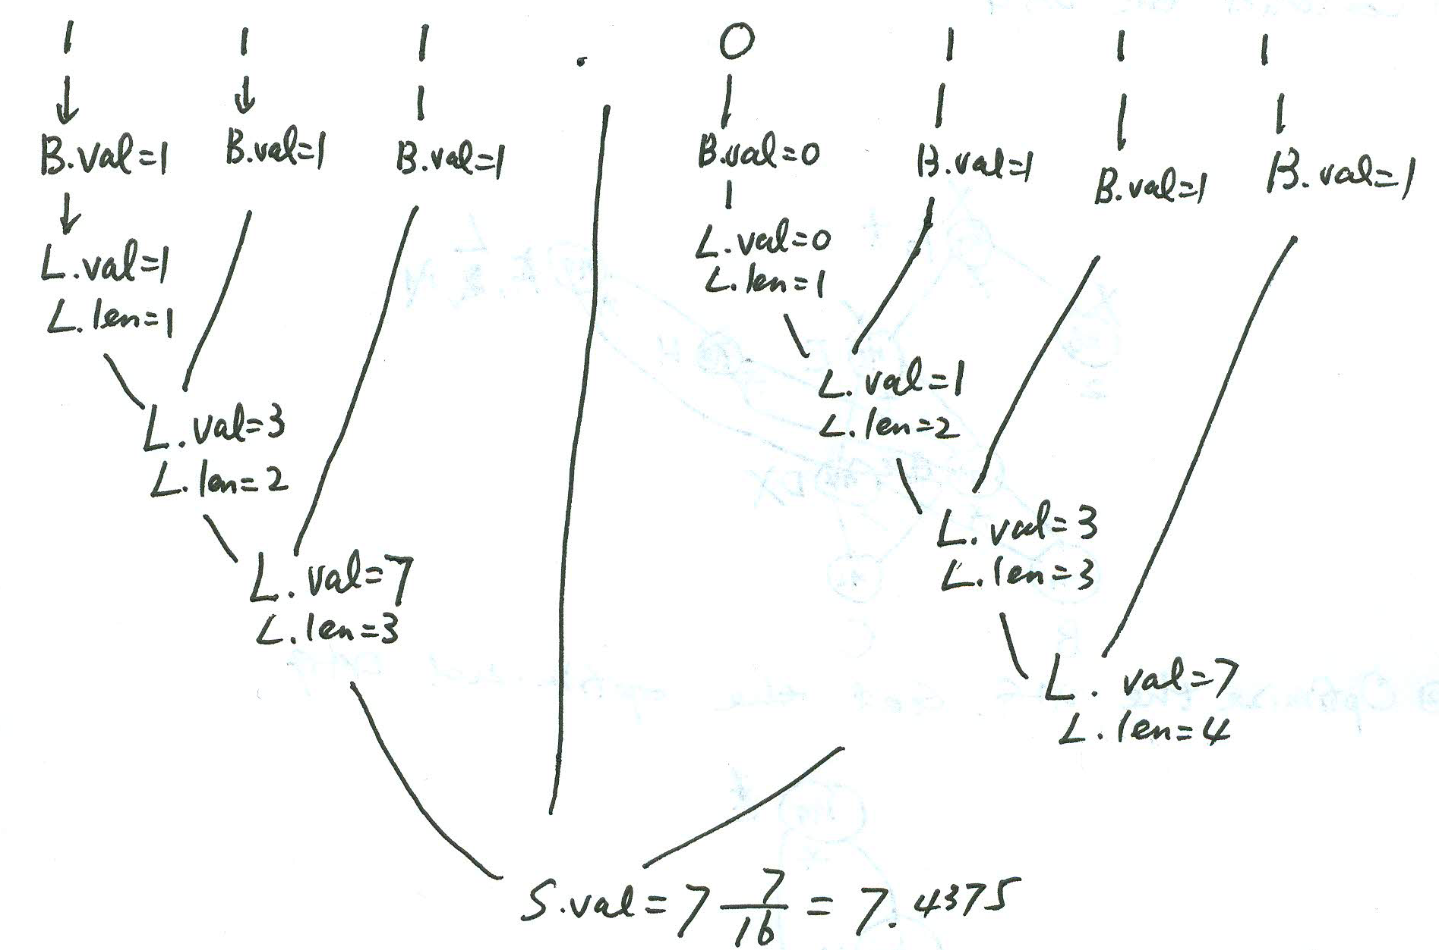

Slide 35
Review
6.Important knowledge points
Chapter 6
Type
Type expression
Construct a type expression for a declaration

Slide 36
Review
6.Important knowledge points
Chapter 7
Stack-based storage allocation
Activation Record Form
C language program
Recursive function
Pascal language program
Display
Construct a maximum stack map for a C recursive program

Slide 37
We assume that the storage organization and the form of activation record used in C language program run-time stack storage allocation are as above. Please construct the run-time stack map when it gets the maximum size for the following C program.
The C program is as the following:
#include <stdio.h>
int x,y,z;
int main()
{
x=35;
y=40;
z=f(x,y);
}
int f(int m, int n)
{
if (n>m) {
int t;
t=f(n,m);
return t }
else
if (n==0) return m;
else {
int t1,t2;
t1=m % n; //remainder of m/n
t2=f(n,t1);
return t2
}
}
Notes: 1) Here we assume that the caller’s sp of Main function is the start address of global variable data area, and the returned address in the activation record of a function (including Main function) is filled by the operating system automatically, you might not care it.
2) The initial value of variable X and Y are 35 and 40 respectively, the start address of stack used in the program is K.

Slide 38
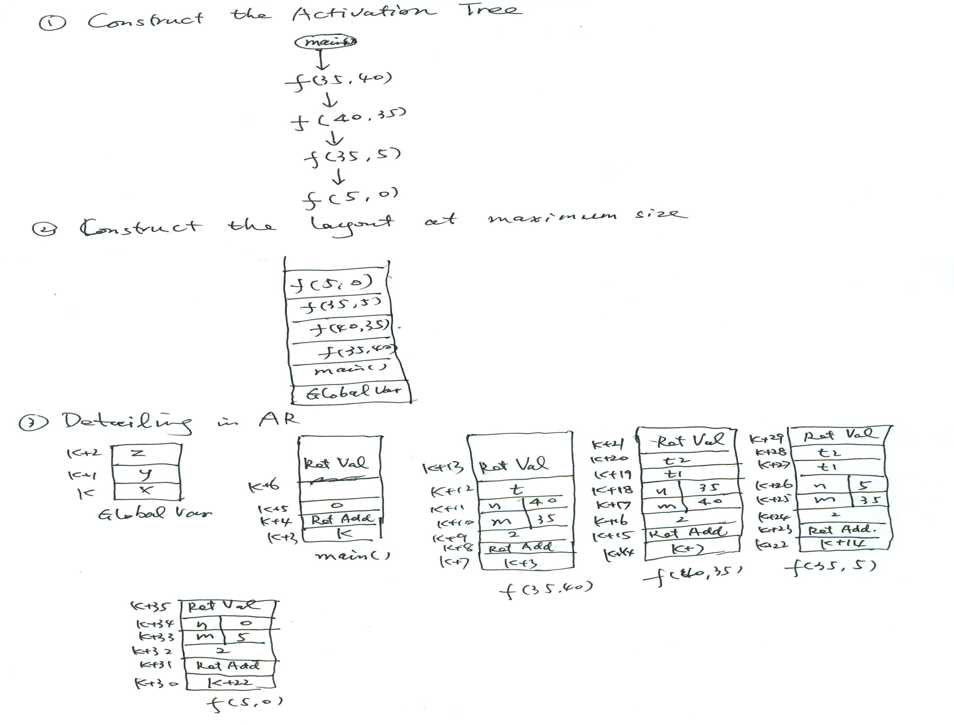

Slide 39
Review
6.Important knowledge points
Chapter 8
TAC
Quadruple
Bottom-up Syntax-directed Program Translation
Assignment statement with array
If and While statement
Translate a program fragment into TAC or quadruple using bottom-up syntax-directed program translation method

Slide 40
Please translate the following program fragment into three address code (TAC) sequence using short circuit code and back-patching techniques.
i=1;
m=0;
loop=0;
while (loop==0 && i<=10) {
j=1;
while (loop ==0 && j<=i)
if (a[i,j] <> a[j,i]) //”<>” means “not equal to”
{
loop=1;
m=1;
}
else j=j+1;
if (loop==0)
i=i+1;
}
if (loop==1)
e=1;
else
e=0;
Notes: Here we assume that the declaration of array A is array [1..20,1..20], each data element of array A would only use 4 storage unit, and the start address of array A’s storage area is addrA.

Slide 41
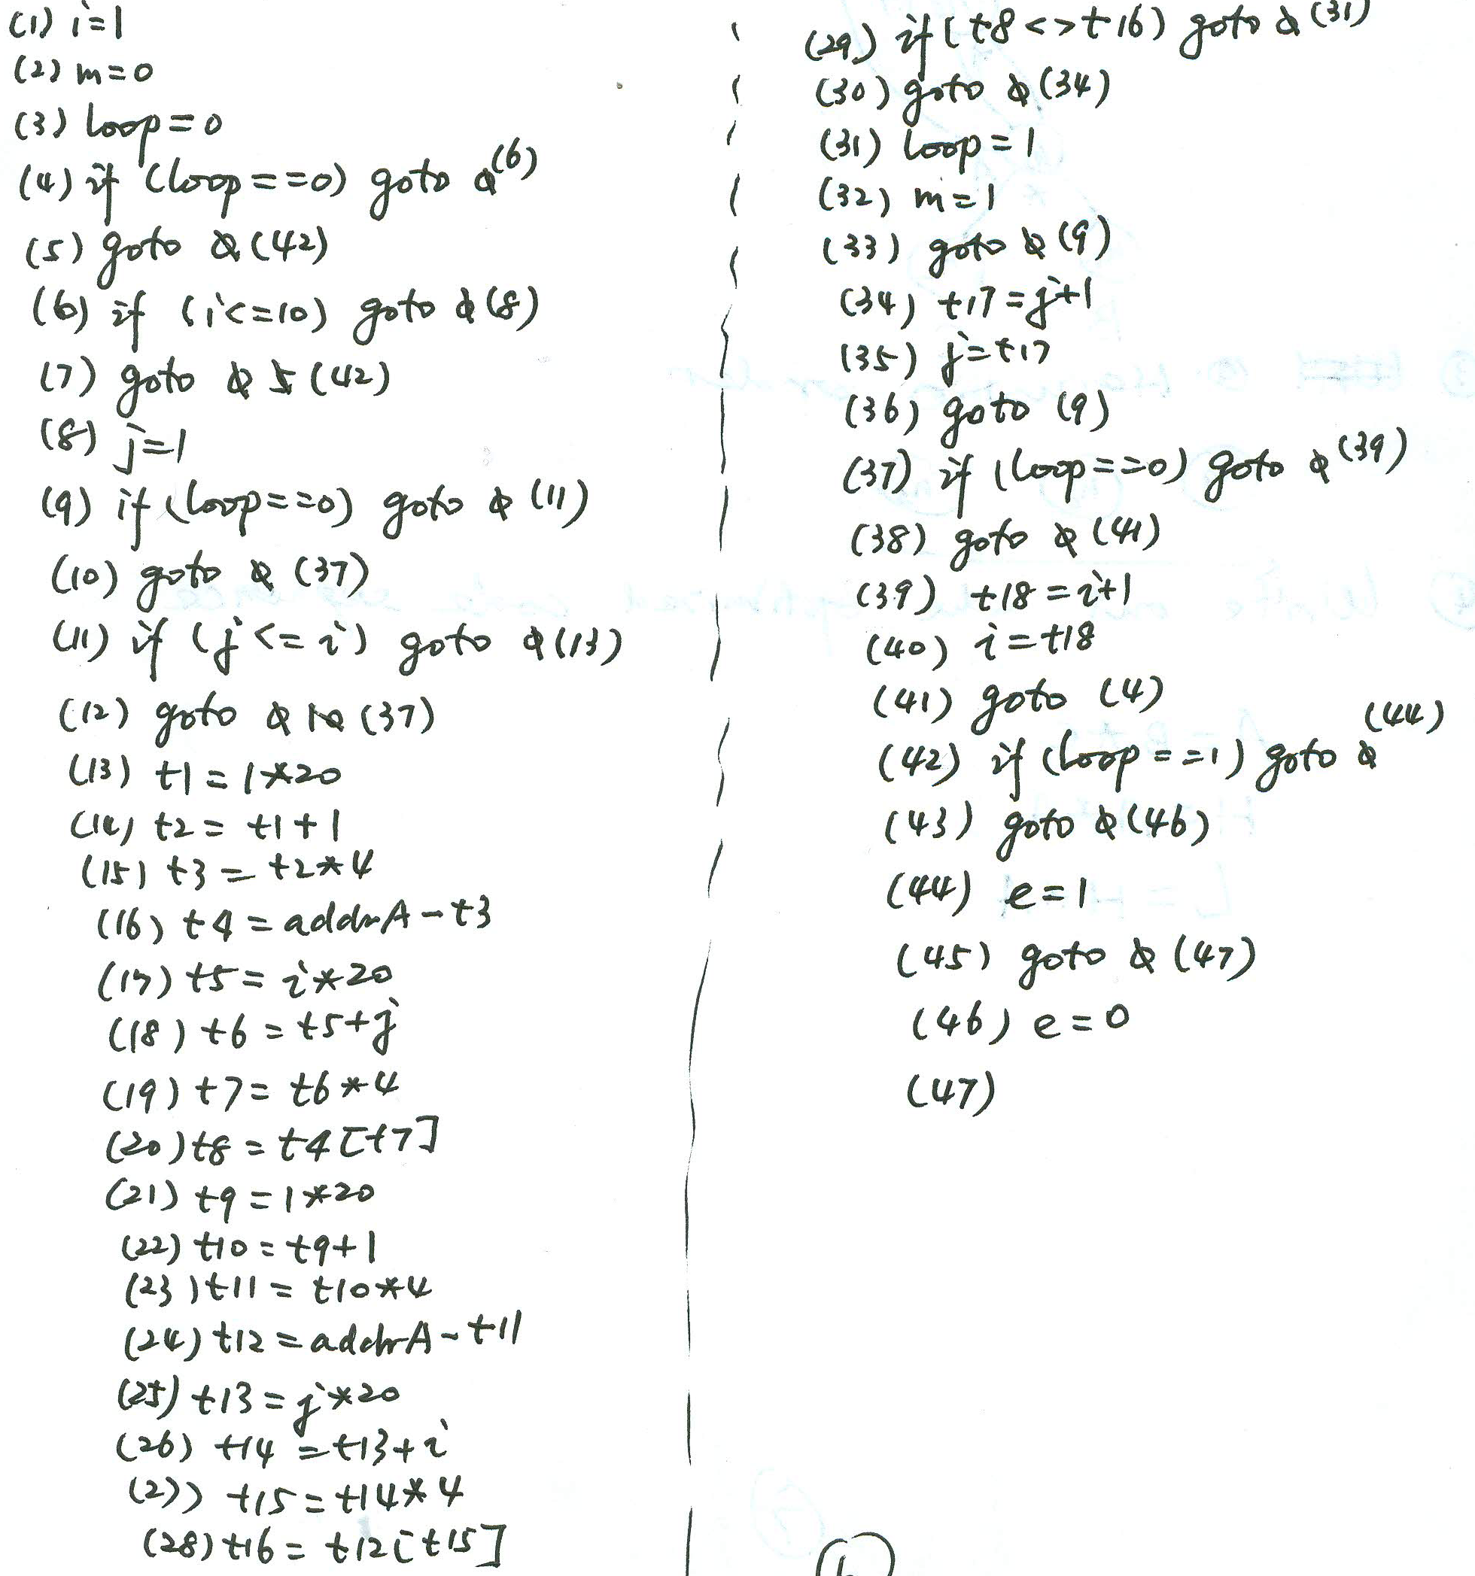

Slide 42
Review
6.Important knowledge points
Chapter 9
Block Division
Construct a flow graph from TAC statements sequence
Optimization in a Block
Constant folding
Common sub-expression
Copy-propagation
DAG
Code rewriting
Optimize a block in DAG method and rewrite the code

Slide 43
Please construct the DAG for the following basic block, optimize the block and rewrite the block in optimized code form. Note that we assume only Variable L would be used later.
A=B*C
D=B/C
E=A+D
F=2*E
G=B*C
H=G*G
F=H*G
L=F
M=L

Slide 44
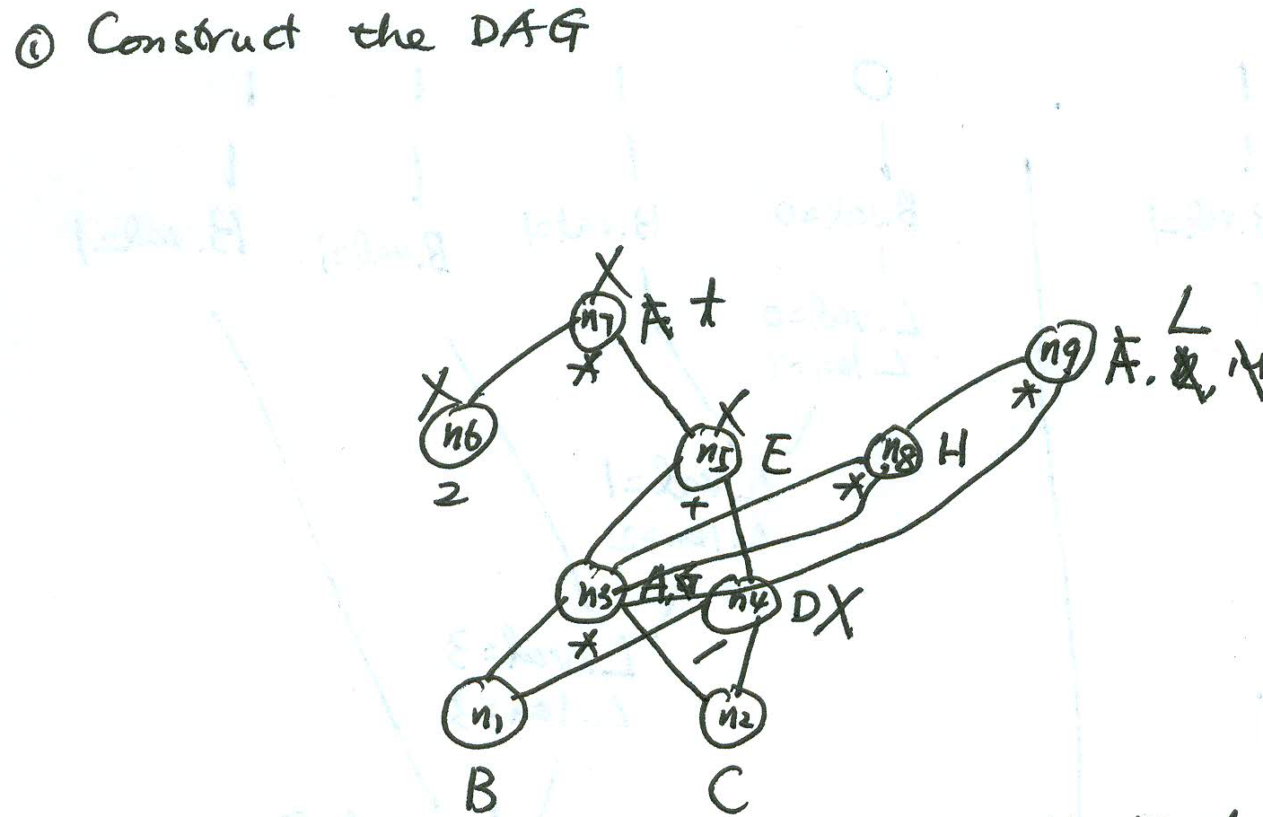

Slide 45
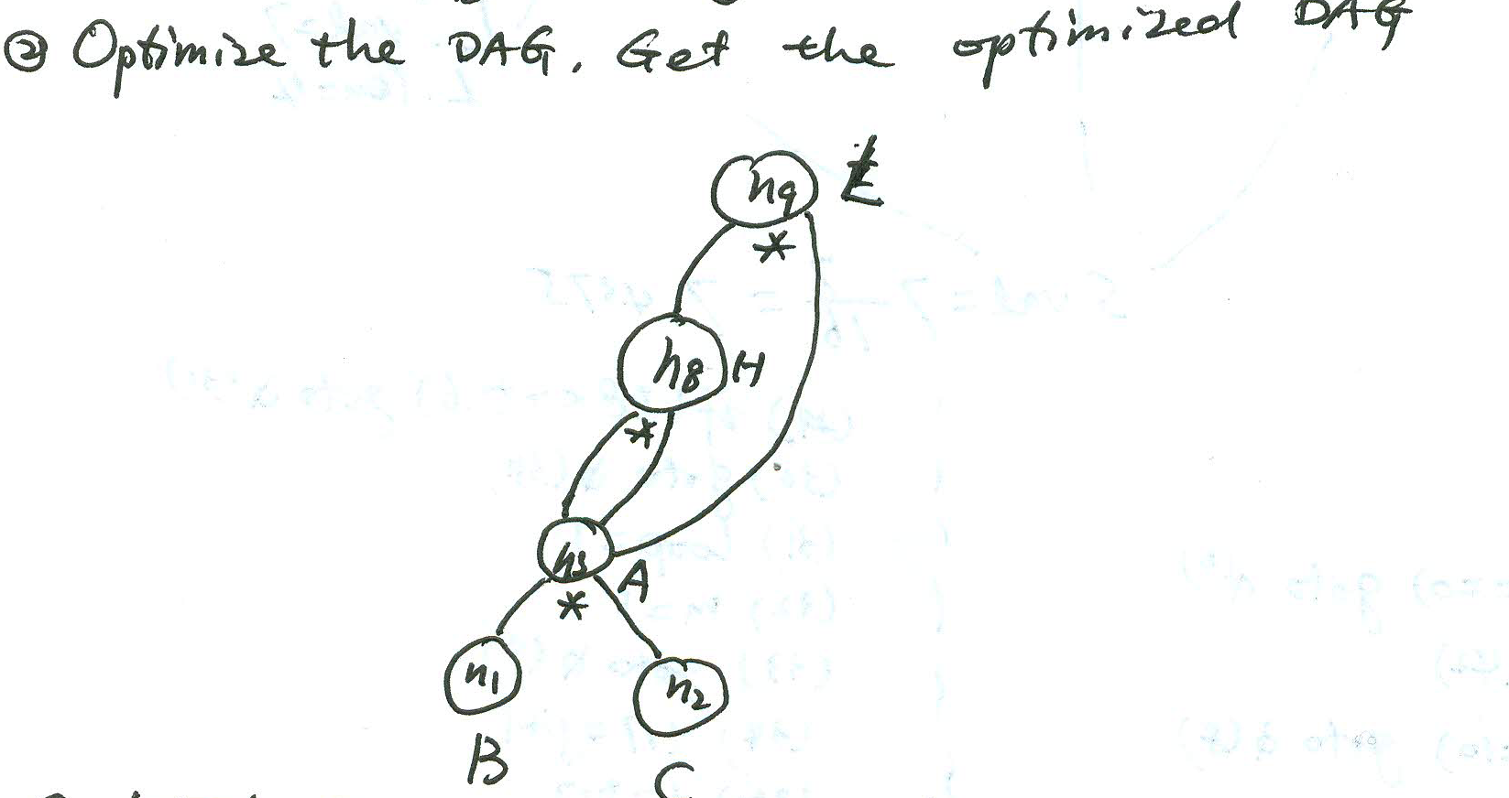

Slide 46
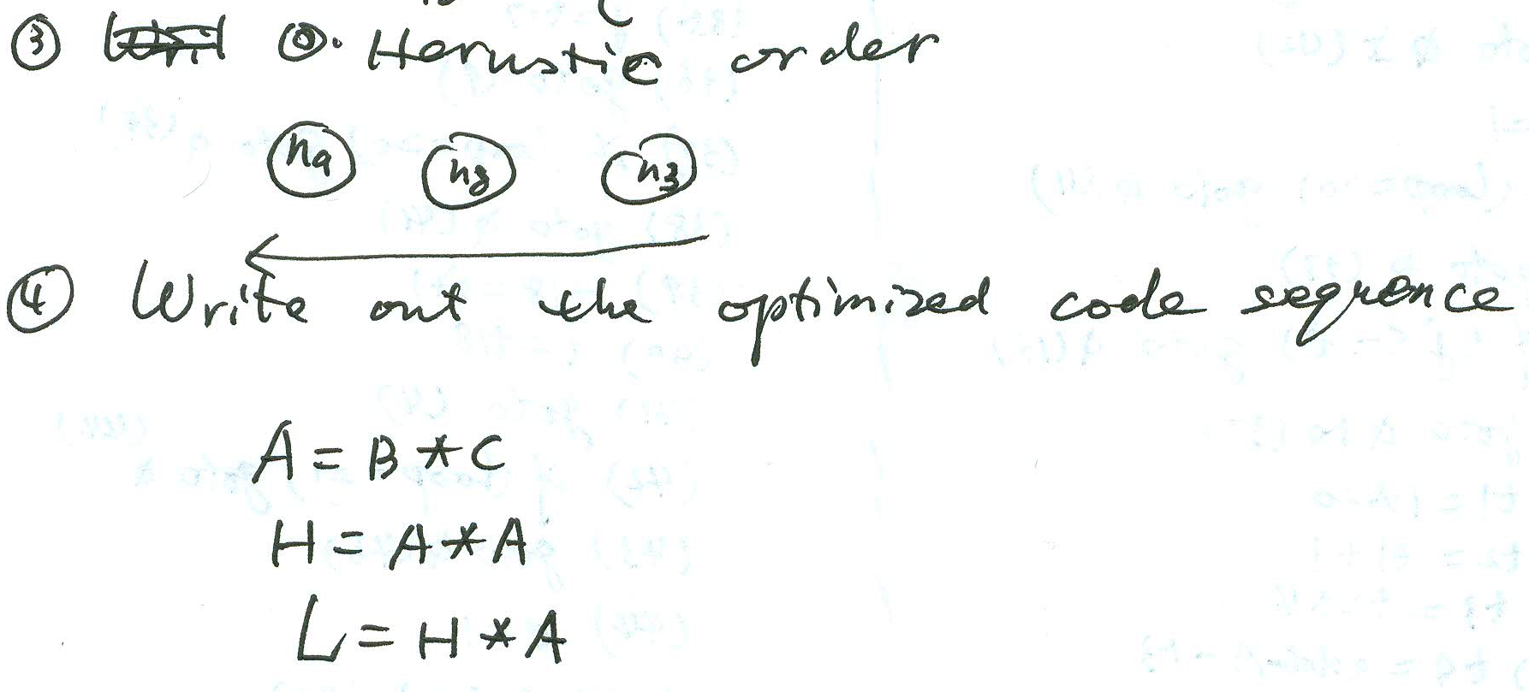

Slide 47
Review
6.Important knowledge points
Chapter 9
Loop seeking
Back edge
Code Motion
Reduction of strength
Find out the loop in a flow graph using dominators and back edge
Data flow analysis
Why should we analyze the data-flow of a program?
How should we analyze the data-flow of a program?

Slide 48
1
2
3
4
6
5
7
8
9

Slide 49
Experiments
1. Lexical Analyzer
Define the set of Regular Expressions of the words
Construct the NFAs
Merge the NFAs into a single NFA
Convert the NFA into a DFA with minimum states
Write the lexical analyzer according to the DFA
Verify the program
Input file: a short source program with the sorts of the words
Output file: the token sequence

Slide 50
Experiments
2. Syntax Analyzer (Parser)
Define the Context-free Grammar of the sentences
Construct the LL(1) Parsing Table/LR(1) Parsing Table
Write the monitor program which uses the LL(1) Parsing Table/LR(1) Parsing Table
Verify the program
Input file: the token sequence
Output file: the derivation sequence/reduction sequence

Slide 51
Experiments
3. Experiment Report
Topic
Motivation
Requirements
Environments
Ideas
Design of Data Structure & Algorithms
Run results
Main Occurred Problems & Solutions
Feelings
….

